Slide 1
The Cranfield Senior Leader Apprenticeship Programmes
www.cranfield.ac.uk/som/slaplus

Slide 2
Stand out from the crowd with Cranfield
A quick overview
A top 10 UK business school for executive customised education.
First business school to provide an Executive MBA under the apprenticeship scheme.
Prestigious globally, in the top 1% of business schools with triple accreditation.
We focus is on development of the leader and provide a real-world, practical business education.
Ranked by
Alumni community
Strong and vibrant international alumni community
Our inspirational faculty
75% industry background.
Content co-designed with industry.
World-leading in leadership transformation.
Industry links throughout courses and through our partnership with Grant Thornton, a top 6 UK professional services firm.
69,000+ Alumni
166
40+
international alumni communities

Slide 3
Celebrating the success of our Apprentices
#1 in Europe Top ranked Apprenticeship Levy provider in the 2020 FT European Business School Ranking*
Our Apprentices We currently have 1,000 apprentices across 30 cohorts attending our programmes.
National coverage
Our Apprentices and Sponsor Companies span across 35 UK counties
98% pass first time 100% success overall and over 80% achieve merit/distinction
*http://rankings.ft.com/businessschoolrankings/european-business-school-rankings-2020
2

Slide 4
Our Senior Leader Apprenticeship+ Portfolio

Slide 5
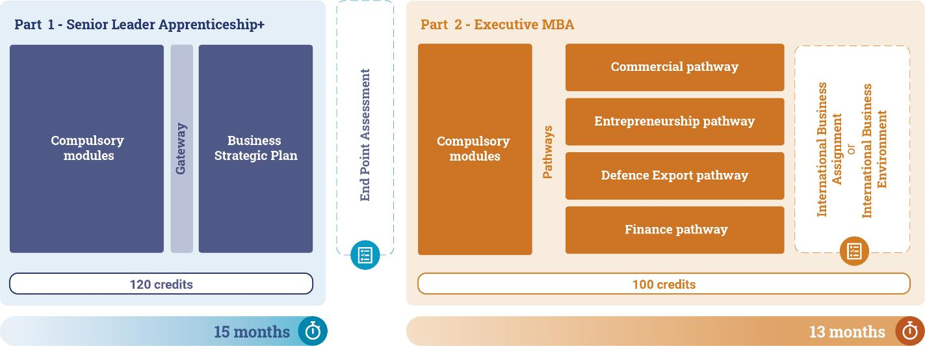
The Senior Leader Apprenticeship+ Executive MBA
The Cranfield Senior Leader Apprenticeship+ Executive MBA in partnership with Grant Thornton aims to provide the full senior leader experience. It combines the core knowledge, skills and behaviours recognised by the Apprenticeship Levy’s Senior Leader Apprenticeship and Executive MBA themes during the first 15 months, with a complementary part two experience which fully develops the leadership qualities and academic foundations of an Executive MBA.

Slide 6
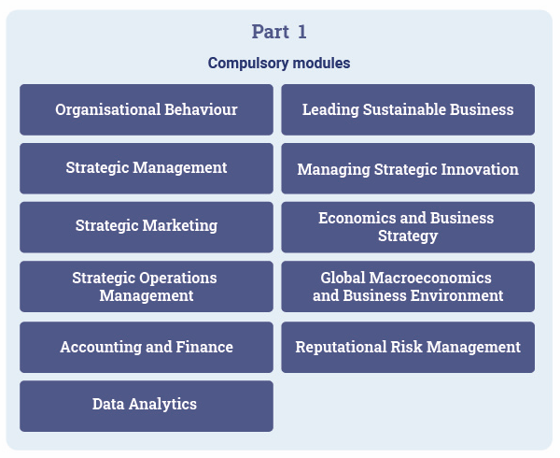
Senior Leader Apprenticeship+ Executive MBA - Part 1
During Part 1, participants spend 15 months learning the core tenets of becoming a senior leader. Part I will deepen their understanding of your organisation and its context they will become more skilled and resilient leaders. Part 1 concludes with an End-Point Assessment (EPA), completed over five months, including the student’s Strategic Business Proposal, supported by the employer. In preparation for your EPA, apprentices will focus on work-based projects, reflective statements, peer reviews, and progress appraisals with your sponsor and coaches to build their portfolio. Here they will evidence the new knowledge, skills, and behaviours they have gained and how you have utilised them to solve complex problems or lead change within your organisation.

Slide 7
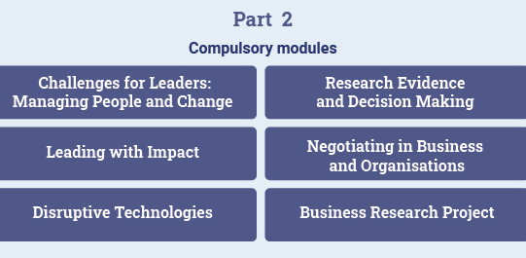
Senior Leader Apprenticeship+ Executive MBA - Part 2
Part 2 will inspire apprentices’ leadership progression, challenging them to think beyond their current role, propel their thinking, career, and business to new heights. Building on the Senior Leader Apprenticeship learning, they will extend their understanding of your business over and above particular functional expertise whilst developing their leadership capabilities ready to carry out senior strategic roles.

Slide 8
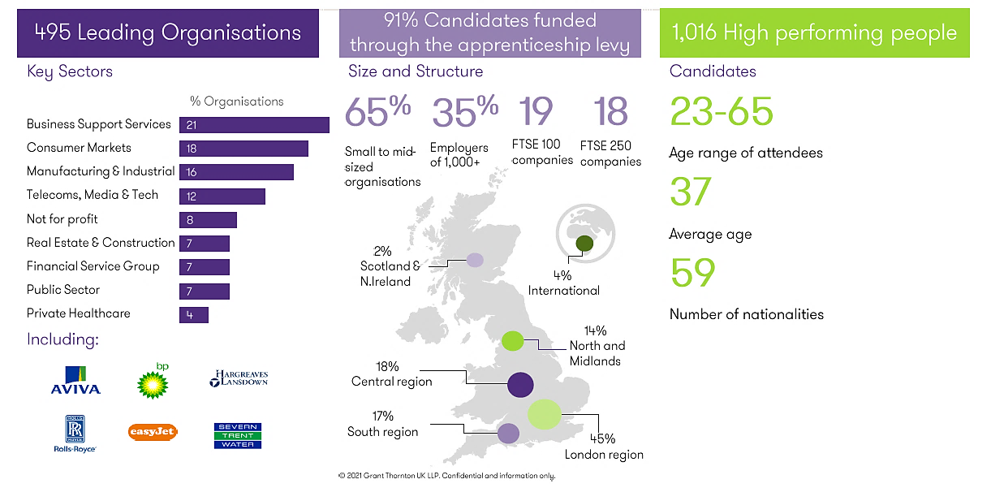
Senior Leadership Apprenticeship+ Executive MBA*: 2017-2021

Slide 9
Senior Leader Apprenticeship+ Programmes Fees and Funding
Our Senior Leader Apprenticeship+ Executive MBA Programmes are 28-month programmes consisting of two core payments.
Part 1 can be fully funded by the UK Apprenticeship Levy: £14,000.
Part 2 can be funded by employer or employee: £13,000.
Optional International Business Assignment/Experience funded by employer or employee: £2,500.

Slide 10
Senior Leader Apprenticeship+ Programmes Fees and Funding
Our Senior Leader Apprenticeship+ MSc programmes are 26-month programmes consisting of two core payments.
Part 1 can be fully funded by the UK Apprenticeship Levy: £14,000.
Part 2 can be funded by employer or employee: £5,000.

Slide 11
Appendices

Slide 12
SLA+ Executive MBA - Pathways

